Slide 1

Camera Module
Weipeng Lin

Slide 2

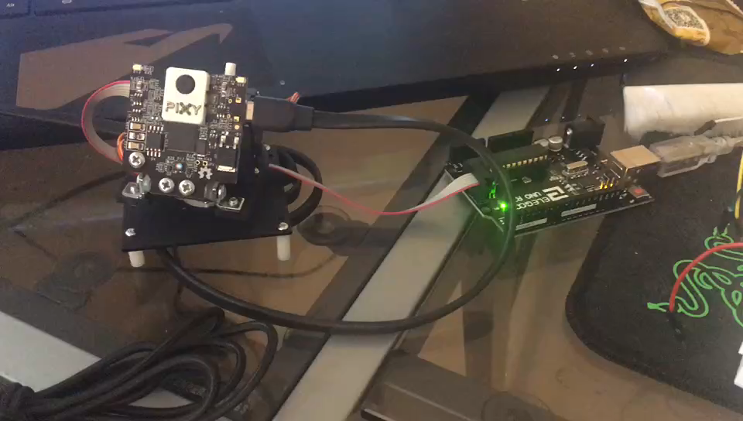
The video

Slide 3
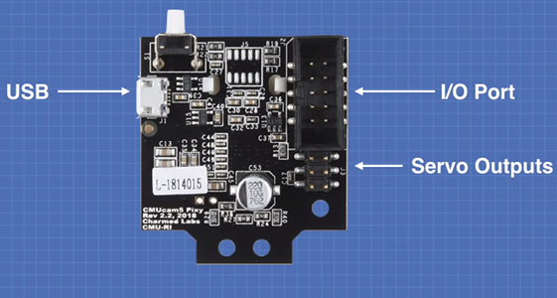
The basic structure of this Module
Processor: NXP LPC4330, 204 MHz,
Processor: NXP LPC4330, 204 MHz,
Processor: NXP LPC4330, 204 MHz,
Processor: NXP LPC4330, 204 MHz,
3.5 x 2.8 x 1.6 inches
Processor: NXP LPC4330
1296×976 resolution
Arduino
Raspberry Pi
Beaglebone Black
LEGO

Slide 4

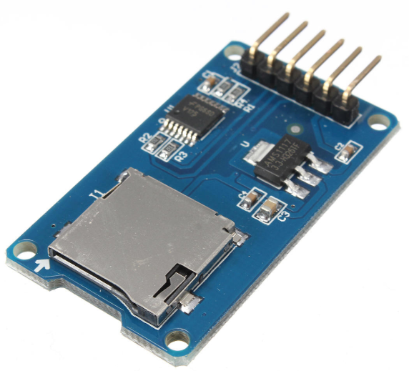
Other parts of this project

Slide 5
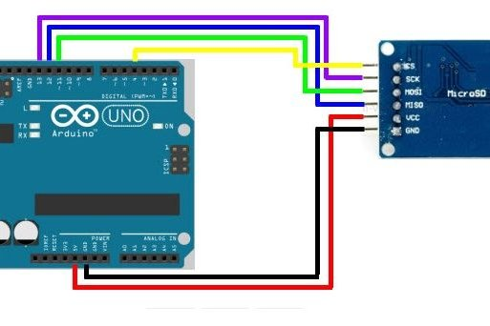
How to connect Arduino and SD card reader?

Slide 6
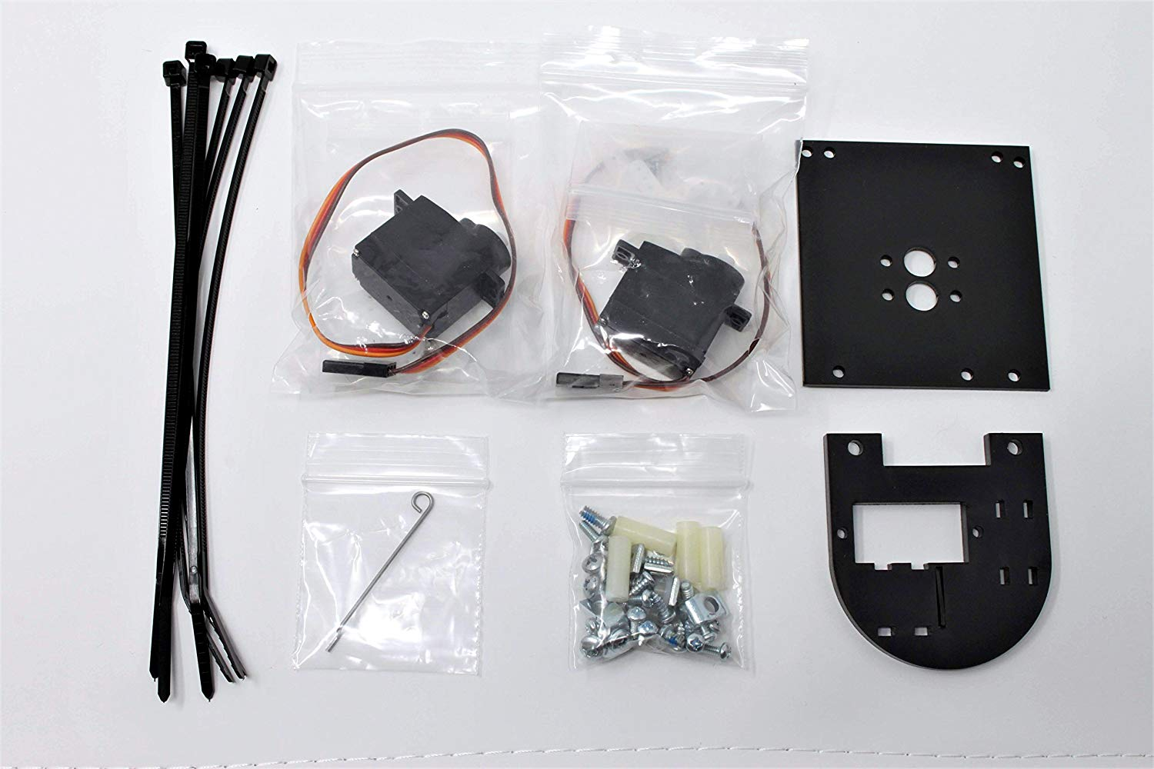
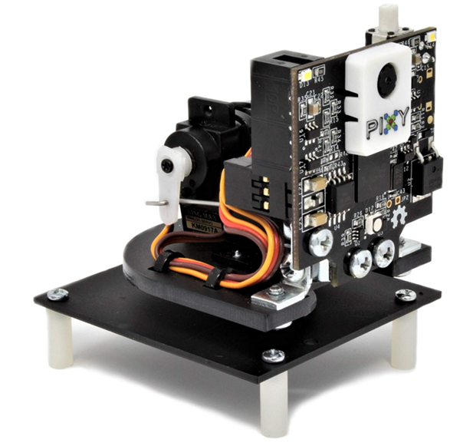
Addition module

Slide 7
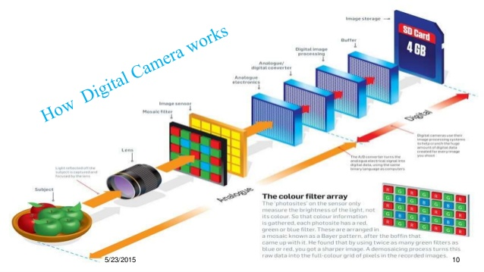

Slide 8


RGB yuv
The luminance signal Y
Chrominance signal U V

Slide 9
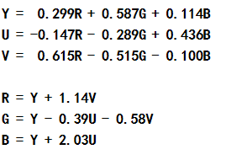
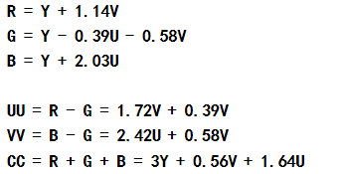
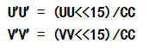
Calculation
The equation of RGB and YUV trans
Reduce the affect from the brightness

Slide 10


Limited
Arduino
Raspberry Pi

Slide 11
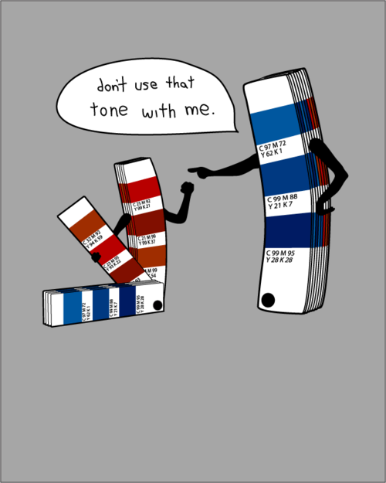
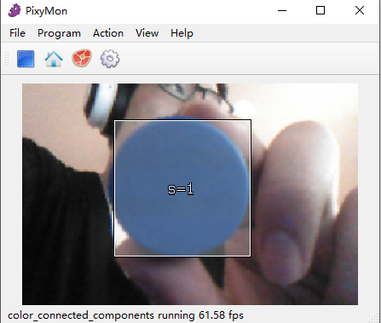
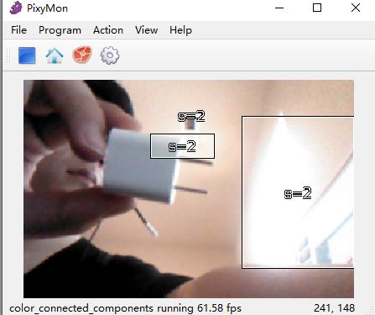

Slide 12

Limited

Slide 13
Cost
A Arduino -- $20
A Pixy2 camera module -$60
SD card and SD card reader -- $10
Wires and resistances -- $1

Slide 14
Reference
https://docs.pixycam.com/wiki/doku.php?id=wiki:v2:overview
https://randomnerdtutorials.com/guide-to-sd-card-module-with-arduino/

